Slide 1
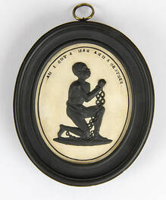
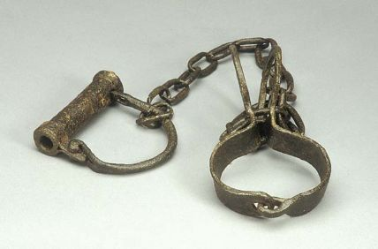
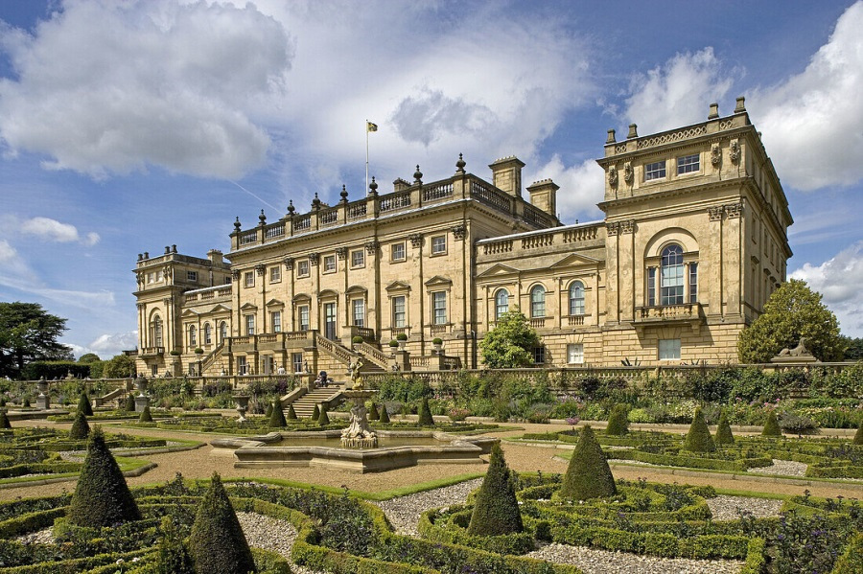
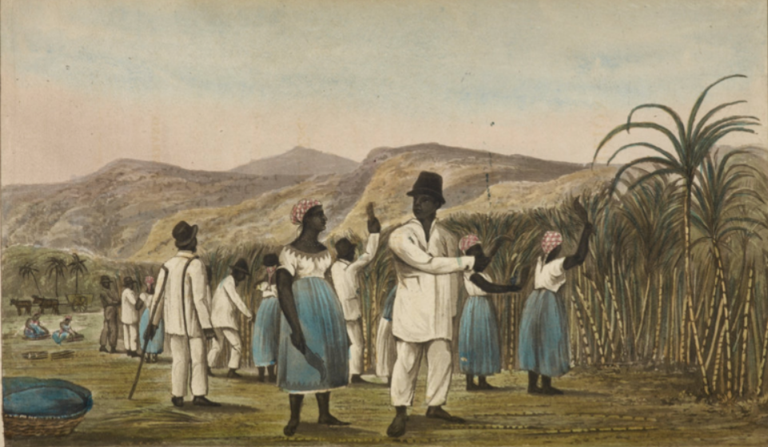
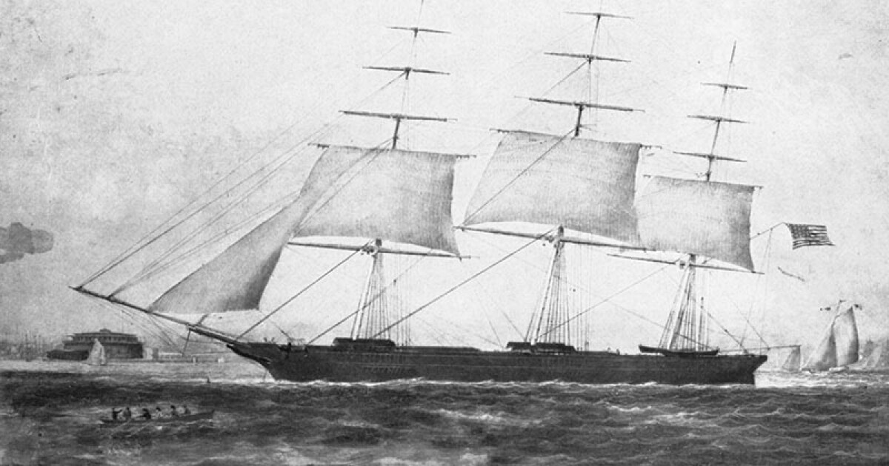

Harewood and the Transatlantic Slave Trade
Pre-Visit Information

Slide 2
Trigger Warning
Harewood House has been the home of the Lascelles family for 250 years. The money that was used to build the House was made in the Caribbean, where the Family generated a significant fortune through the transatlantic slave trade and the production of sugar. Their business encompassed the systematic enslavement, transportation and exploitation of African people. Harewood House and its collection contain material collected and created by societies in which very different attitudes and behaviours were normalised.
We understand that some pupils and teachers may find the collection and its context challenging and upsetting and we will do our best to support your visit. If you have any specific questions or requests, please contact the Learning Team on learn@harewood.org.
Today Harewood House is cared for by the Harewood House Trust, an educational charity who are committed to using our collection, landscape and history, to create a better and more inclusive society.
Notes:
Notes for teachers

Slide 3
What was the Transatlantic Slave Trade?
The Transatlantic Slave Trade was the process by which African people were taken from their homeland and forced to work on plantations in North and South America and the Caribbean.
It ​is sometimes called the Triangular Trade Route because of the shape of the route taken by the transporting ships.
The people that were involved in the Transatlantic Slave Trade often became very rich. This was because the goods the ships were carrying were sold for a higher price at each part of the journey. Enslaved workers were also growing these high-value products for free.
Why do we use ‘enslaved person/worker’ rather than ‘slave?’
Using enslaved person instead of slave gives them an individual identity and shows them as a single person rather than one of many. It shows that they were someone that was enslaved (meaning they were forced into slavery) and it isn’t who they are.
What is a plantation?
A plantation is a farm that grows lots of the same crop to make money. Many plantations in the Caribbean grew sugar cane which would be made into sugar for tea and cakes.

Slide 4
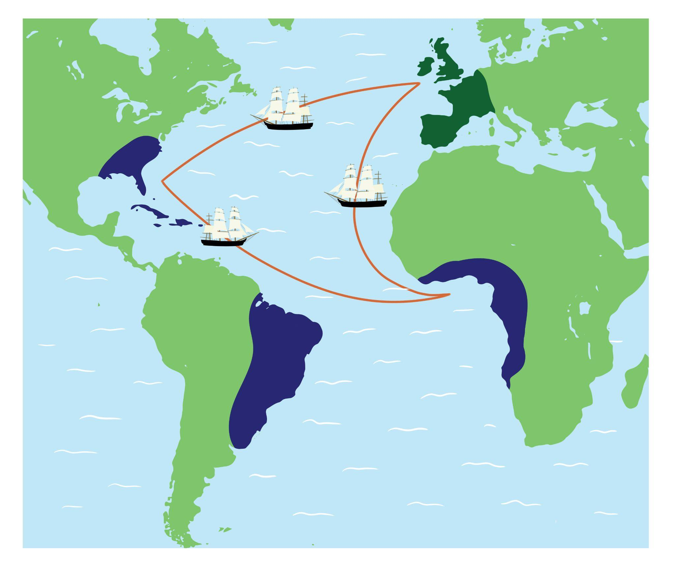
Triangular Trade Route

Slide 5
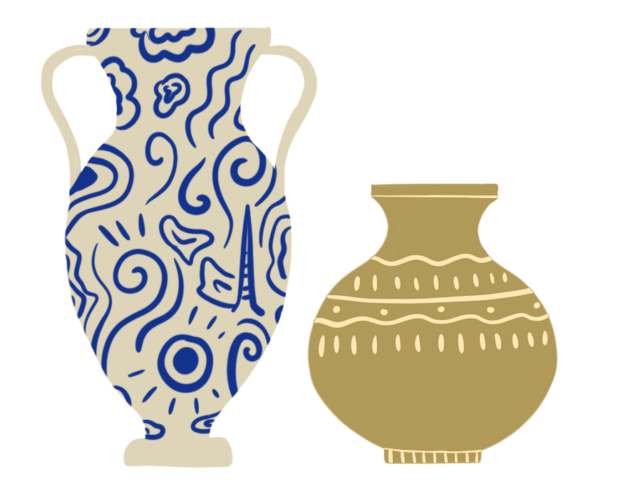
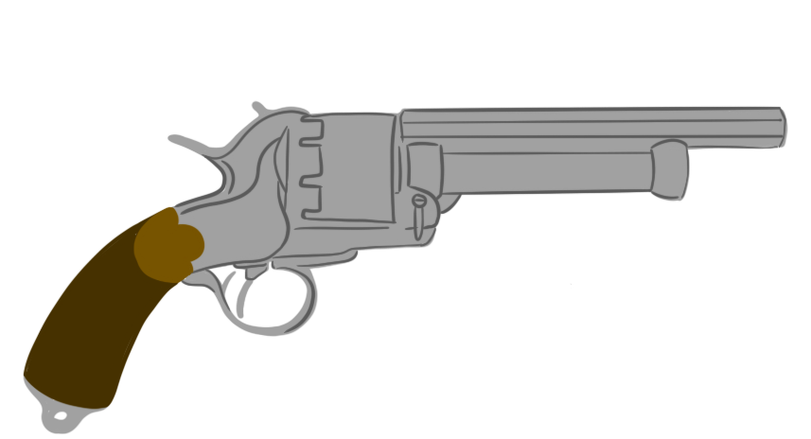

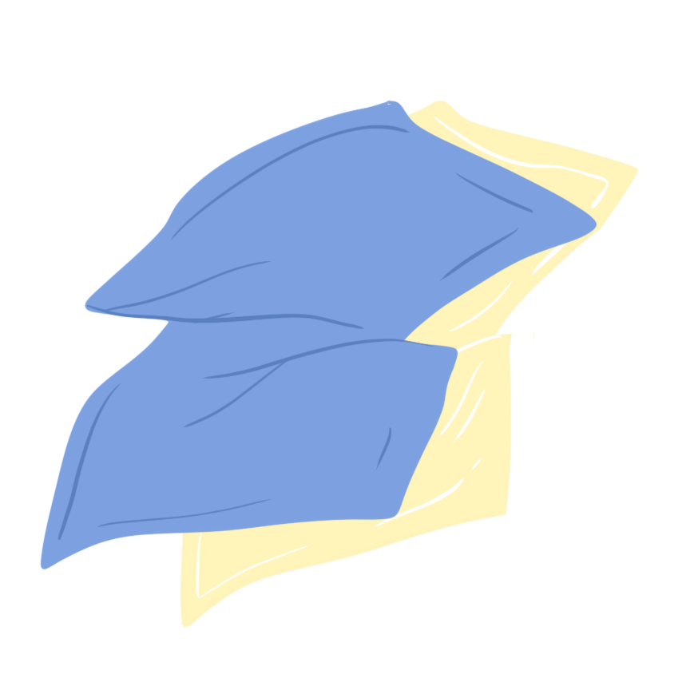
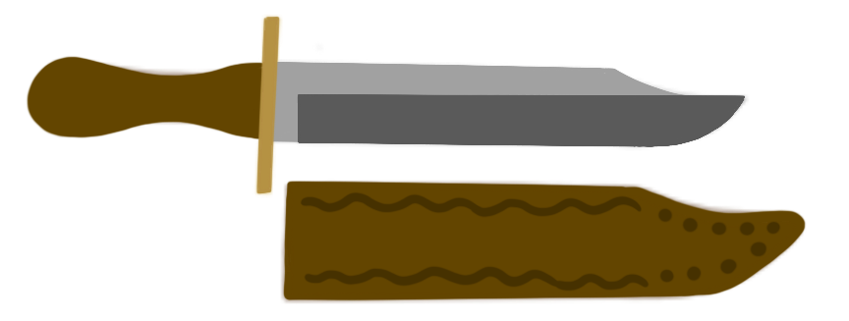
Journey 1
Europe to West Africa
Large ships were filled with items like textiles, guns, knives, copper and pottery.
The ships left European/British ports (like Liverpool and Bristol) and headed to West Africa.
When the ships arrived, these goods were then sold to African leaders in exchange for enslaved Africans.
firearms
pottery
brass
textiles
knives

Slide 6
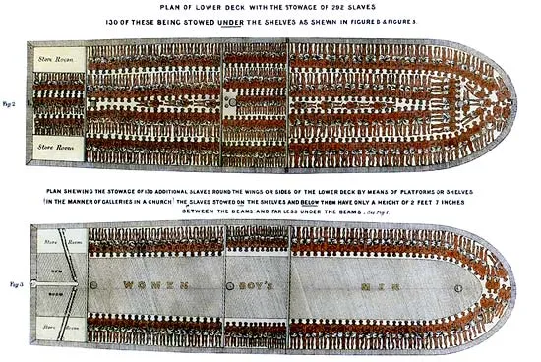
Journey 2
West Africa to North America/South America/the Caribbean
The enslaved Africans were shipped across the Atlantic Ocean to the Caribbean and the Americas.
The journey usually took six to eight weeks. Conditions on the ship were horrific and more than a million people died on this part of the journey.
This journey was sometimes called the Middle Passage.
Notes:
Trigger warning

Slide 7
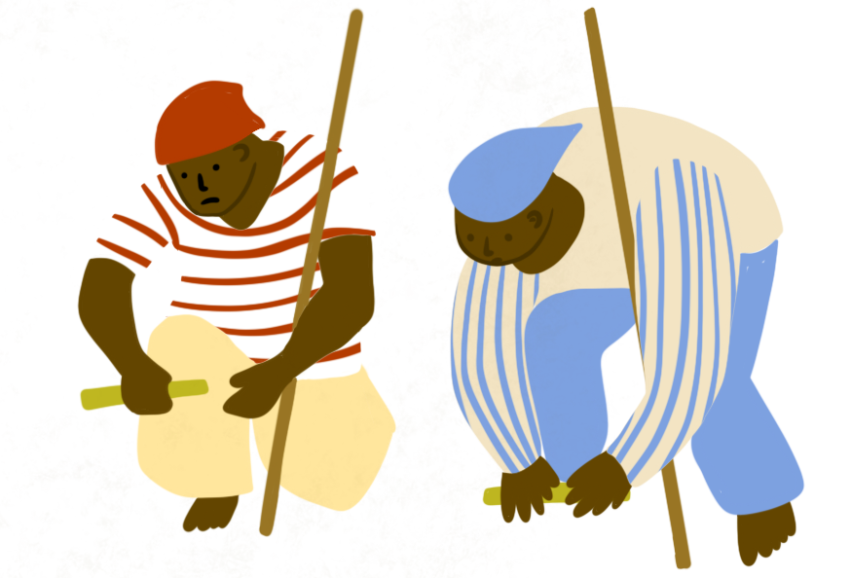
Journey 3
North America/South America and the Caribbean to Europe
When the ship docked, merchants/slave traders sold the enslaved Africans to plantation owners to work on their plantations to grow goods like sugar, rum, coffee, cacao (chocolate), raw cotton and tobacco
The merchants used this money to buy the plantation goods to sell back to people in Britain and Europe
enslaved African people

Slide 8
Activity
The Triangular Trade route involved the buying and selling of many different things, including enslaved African people.
Test your knowledge of the Triangular Trade route by labelling the map provided.
Cut out and stick the map in your book
Cut out the place name labels and numbers and stick them in the correct place on the map
Cut out the items and stick them in the place where they were traded on the map
Challenge:
Do we still buy these items today? If so, where do they come from? Has much changed since the Transatlantic Slave Trade?
Choose an item to research and see what you can find out.

Slide 9
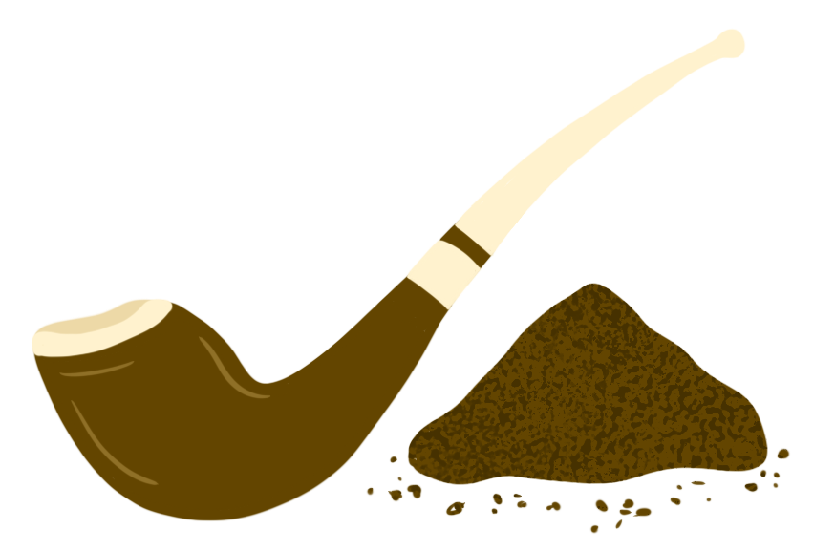
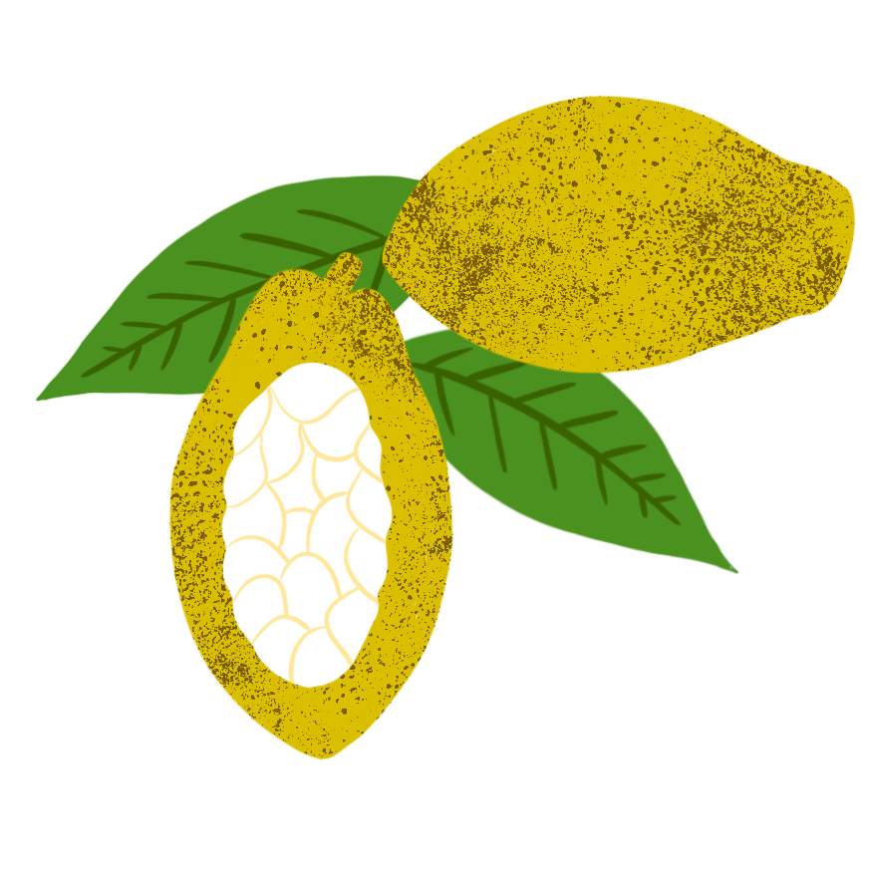
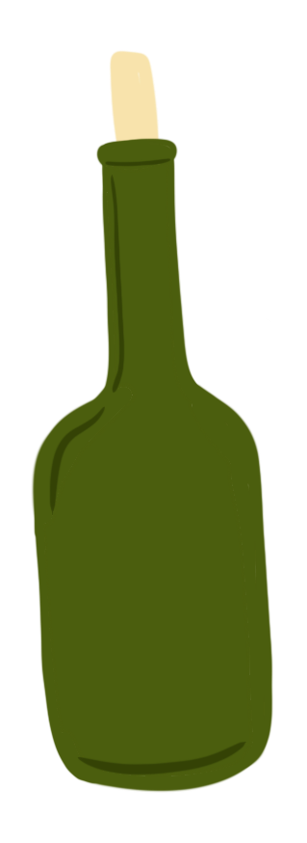

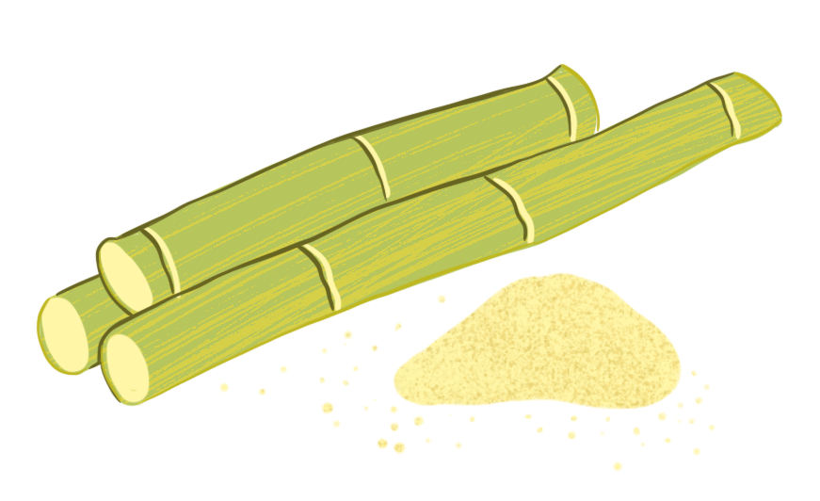
Can you label the highlighted areas on the map?
Great Britain
knives
West Africa
tobacco
enslaved African people
North America
South America
cacao (chocolate)
The Caribbean
rum
brass
Can you number the three points of the Triangular Trade route? Where did the route begin?
textiles
raw cotton
1
2
3
pottery
firearms
sugar

Slide 10
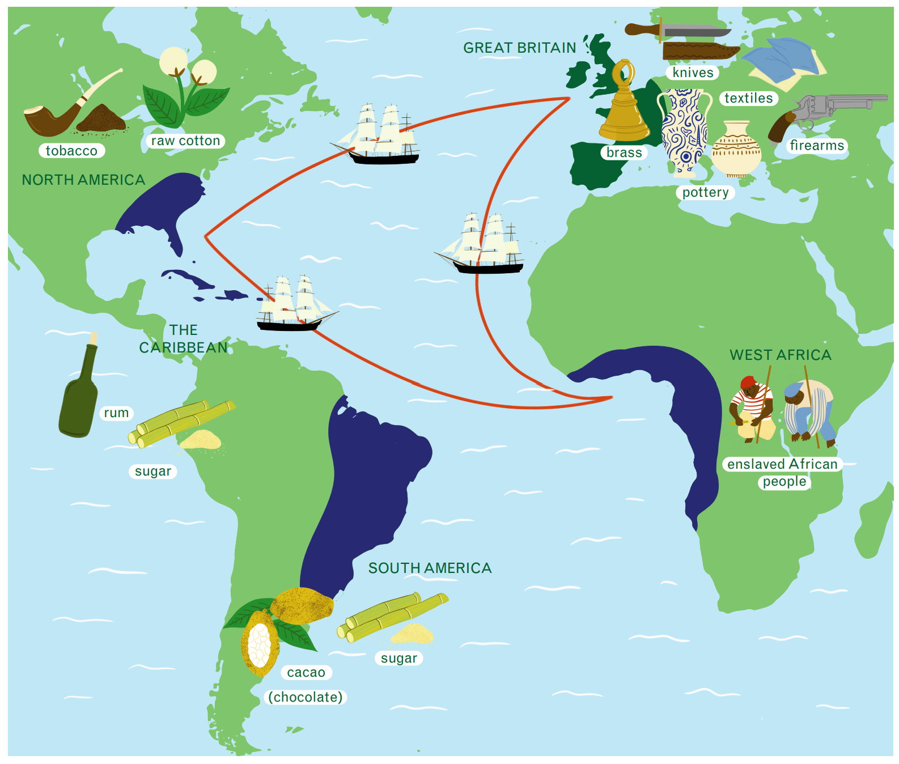

Slide 11
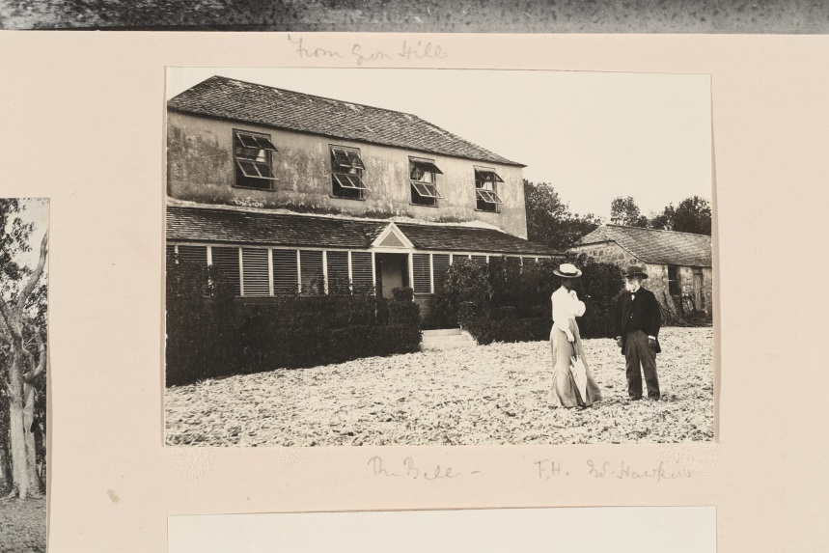
Harewood and the Transatlantic Slave Trade
Harewood House was home to the Lascelles family and the Earl and Countess of Harewood for more than 200 years.
The family’s money, power and influence came from the sugar business in the Caribbean and the Transatlantic Slave Trade.
They were involved in every part of the Triangular Trade Route. They sold sugar, transported it, had money in slave ships and sugar warehouses in London.. They also owned and managed plantations where enslaved people were forced to grow sugar and cotton.
Belle plantation, Barbados

Slide 12
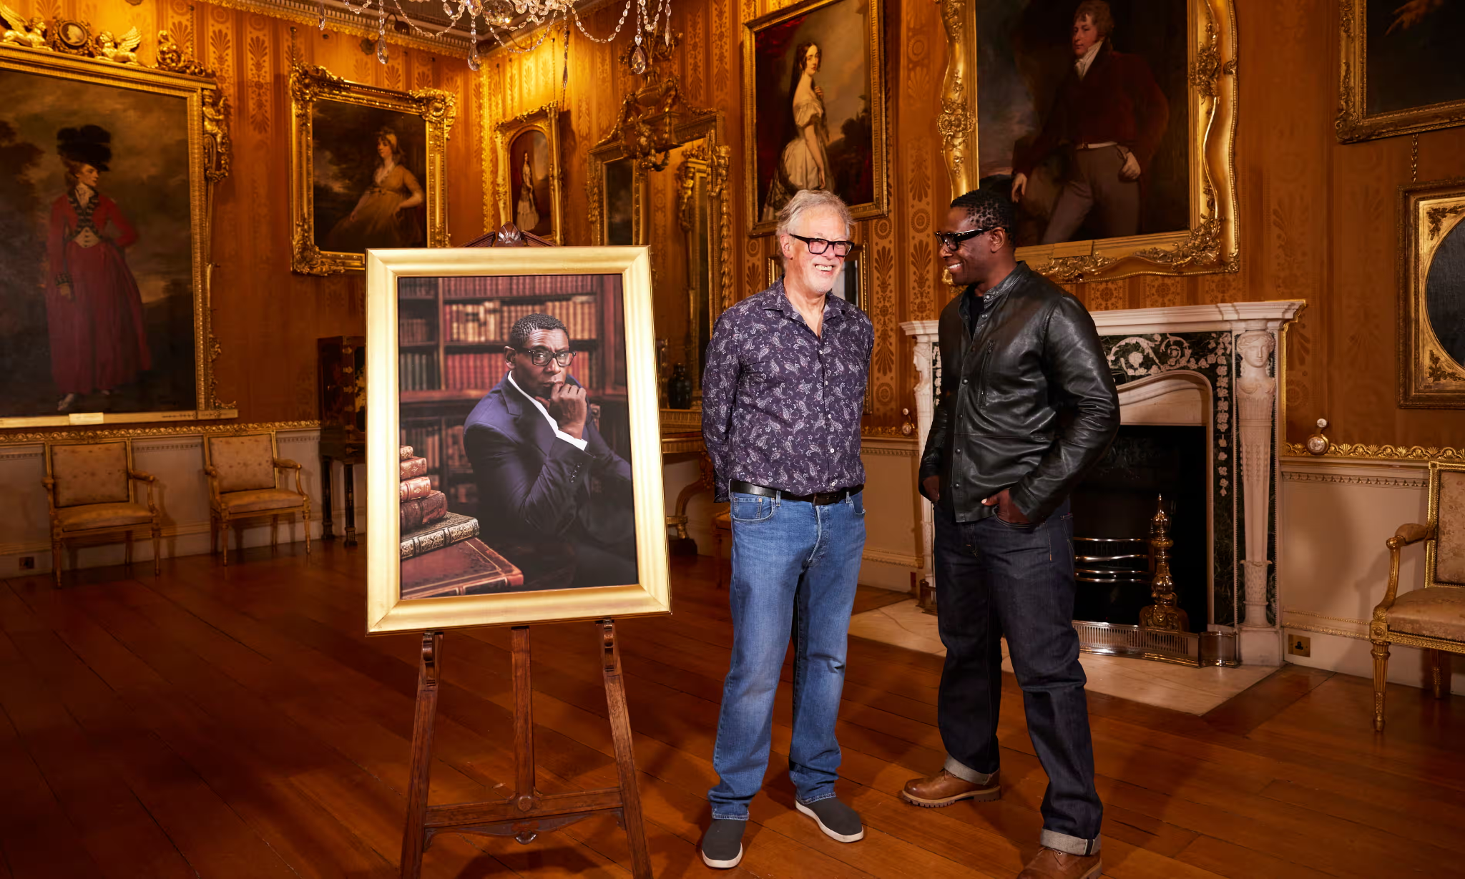
Harewood and the Transatlantic Slave Trade
Harewood continues to support local Caribbean charities, celebrate Caribbean culture and share and educate people on the story of our past, creating a more inclusive future.
The current Earl and Countess started a project called Missing Portraits in 2022 with the aim to diversify their portrait collection and tell stories of inspiring Black people with connections to Harewood
Notes:
Watch David Harewood interview below
https://www.youtube.com/watch?v=KiPuklu41tw

